Slide 1



CROP YIELD PREDICTION FOR GOOGLE GRID

Slide 2

GUIDE
MRS. POONAM BARI
GROUP MEMBERS
Sahil Bagate | 5021105
Neil Dsouza | 5021113
Dhanashree Patil | 5021142
Suyash Malekar | 5021166

Slide 3
INTRODUCTION
Agriculture
Accurate crop yield prediction
Data Analysis and Deep learning model
Dataset
Climate data and auxiliary variables

Slide 4

LITERATURE SURVEY
TITLE, AUTHOR, AND PUBLICATION YEAR | KEY POINTS | ADVANTAGES | RESEARCH GAPS
Predicting Agriculture Yields Based on Machine Learning Using Regression and Deep Learning (2023) Priyanka Sharma et al. [IEEE Access] | Compared ML and DL models like RF, XGBoost, LSTM, CNN for Indian crop yield prediction; RF achieved 98.96% accuracy. | Comprehensive comparison of models addressing India's food demand challenges. | Limited data usage and geographic scope confined to India.
Crop Yield Prediction using ML and DL Techniques (2023) Kavita Jhajhariaa et al. [ICMLDE] | Used models like RF, SVM, LSTM, and Lasso with Rajasthan's data; RF performed best. | Integrates soil, rainfall, and crop data to guide farmer decisions. | Region-specific dataset limits generalizability: some models demand high computation.
Prediction of Crop and Yield in Agriculture Using ML (2021) Akshay Kumar Gajula et al. [IEEE-9579843] | Used KNN to classify crops based on soil parameters and climatic conditions across 15 agro zones. | High accuracy, fast predictions, and user-friendly output for farmers. | Doesn't handle unexpected climate changes well; poor cross-region applicability.
Crop Yield Prediction using ML Algorithm (2021) D. Jayanarayana Reddy et al. [IEEE 9432236] | Used SVM, CNN, DNN to predict yield via soil and weather data; effectiveness depended on input quality. | ML can handle complex datasets; ANN models work well with limited data. | High computational cost and difficulty handling non-linear data with some models.

Slide 5

LITERATURE INFERENCE
Models Used:
Statistical Models: Xgb boost, Random Forest
Neural Network Models: RNN, CNN, LSTM
Accuracy: Average accuracy for the model is 80-90 percent for small datasets.
Identified Research Gap:
Limited adaptability: Traditional methods struggle to account for dynamic agricultural factors like weather and soil changes.
Incomplete data integration: Existing models often neglect comprehensive analysis of soil, climate, and crop interactions.

Slide 6

















DATA & METHODOLOGY
SQL INNER JOIN for Environmental Data
Add Day Column & Geopy Mapping
Country/State Analysis
LSTM & BiLSTM Model Training
Yield Prediction
Data Collection
Transform Format: Horizontal to Vertical
Data Normalization
Trend & Correlation Analysis
Performance Evaluation: RMSE, R²

Slide 7
DATA COLLECTION
Uses data from "The Future Crop Challenge" (Kaggle, June 2024).
Data spans 39 years (1982–2020).
Key variables:
Climatic: Temperature, precipitation, radiation.
Agronomic: Soil texture, nitrogen use, CO₂ concentration.
Target variable: Crop yield (tons per hectare).
Study focuses on how climate and soil affect maize yield.

Slide 8
DATA STRUCTURE & FORMAT
Each row has unique latitude, longitude and year.
Climate variables stored as 240-day time series per variable.
Static agronomic data added separately (e.g., soil, nitrogen).
Data stored in .parquet files for efficient handling.
Dataset has:
3394 locations.
Over 30 million rows.
39 years of data per location.

Slide 9

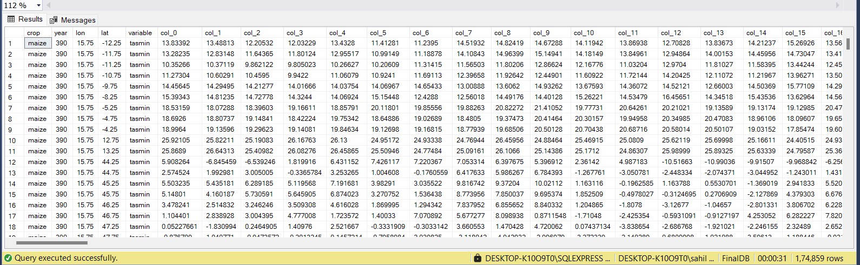

IMPLEMENTATION DETAILS
UNPROCESSED DATA :

Slide 10
DATA PREPROCESSING
All files imported into SQL tables.
INNER JOIN used to merge data into one dataset.
Data reshaped from horizontal (240 columns) to vertical (day-wise rows).
Geolocation (country, state) added using geopy library.
Final dataset prepared for country/state-wise analysis.

Slide 11
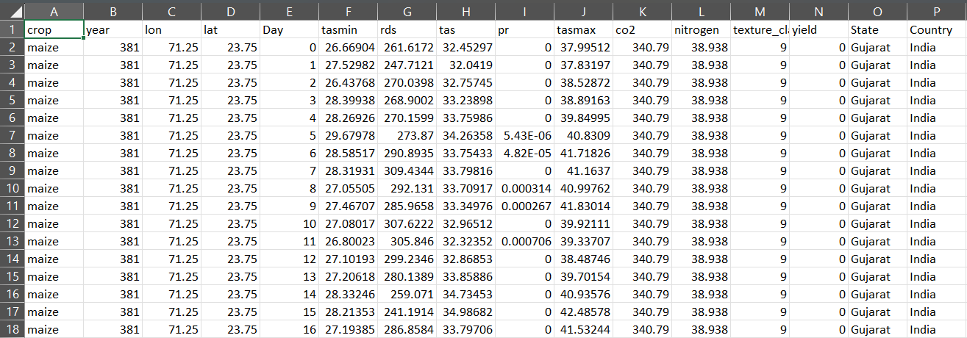
PREPROCESSED DATASET:

Slide 12
DATA ANALYSIS METHODS
Trend analysis:
Plotted yearly maize yield trends for each country.
India state-wise analysis:
Created choropleth map to show yield distribution by state.
Correlation analysis:
Examined relationships between yield and variables like:
Rainfall
Temperature
Radiation
CO₂
Nitrogen

Slide 13
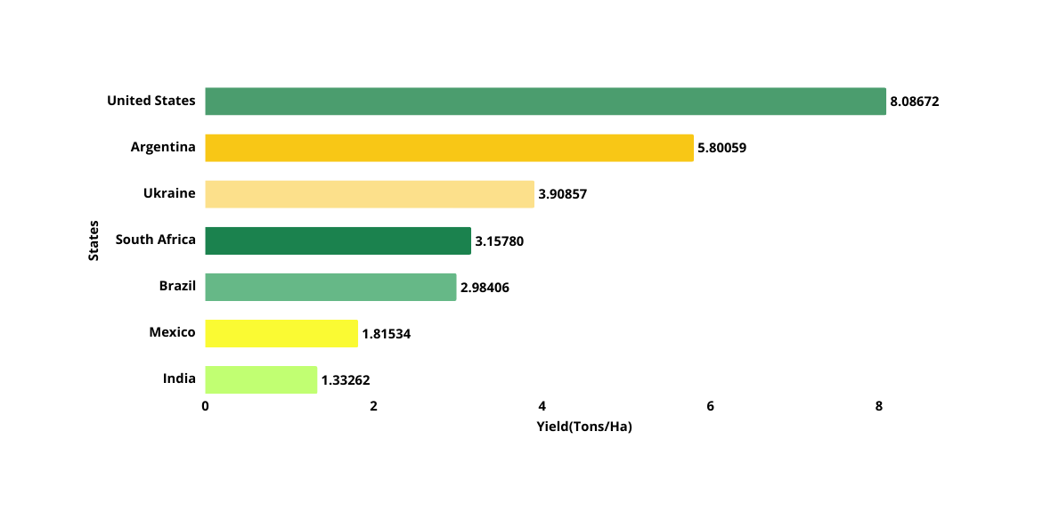
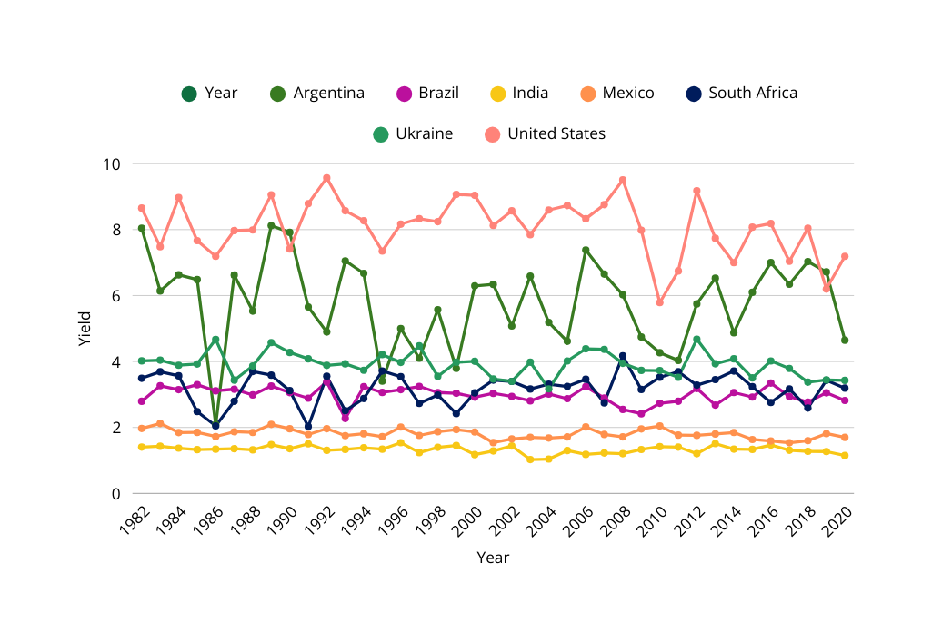
EXPLORATORY DATA ANALYSIS(COUNTRY-WISE)
AVERAGE OF CONTINENTS-WISE YIELD
ANNUAL MAIZE YIELD TRENDS BY COUNTRY

Slide 14
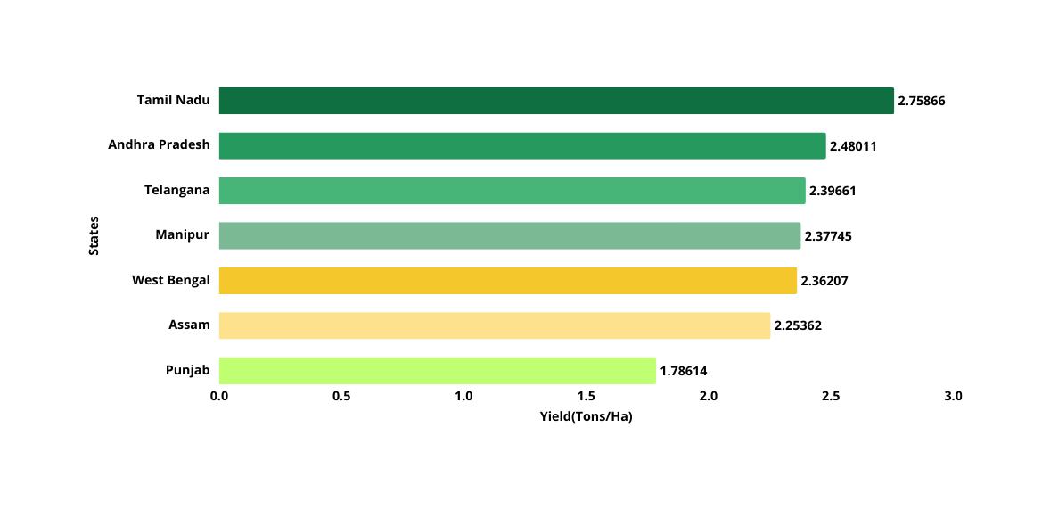
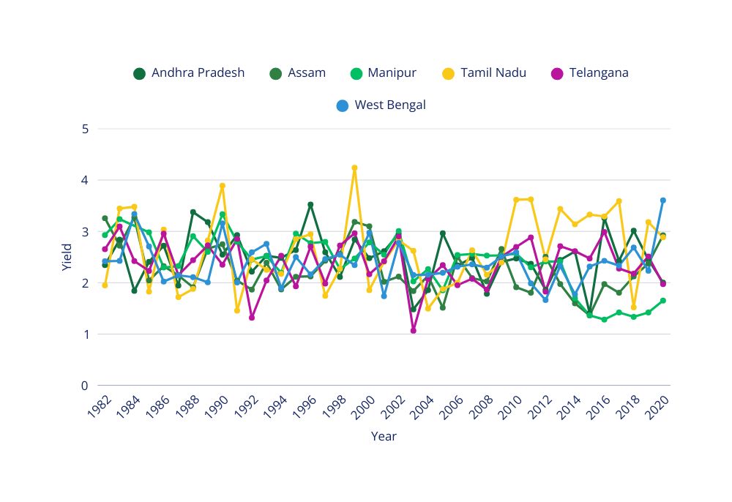
EXPLORATORY DATA ANALYSIS(STATE-WISE)
AVERAGE MAIZE YIELD OF INDIA
ANNUAL MAIZE YIELD TRENDS FOR INDIAN STATES

Slide 15
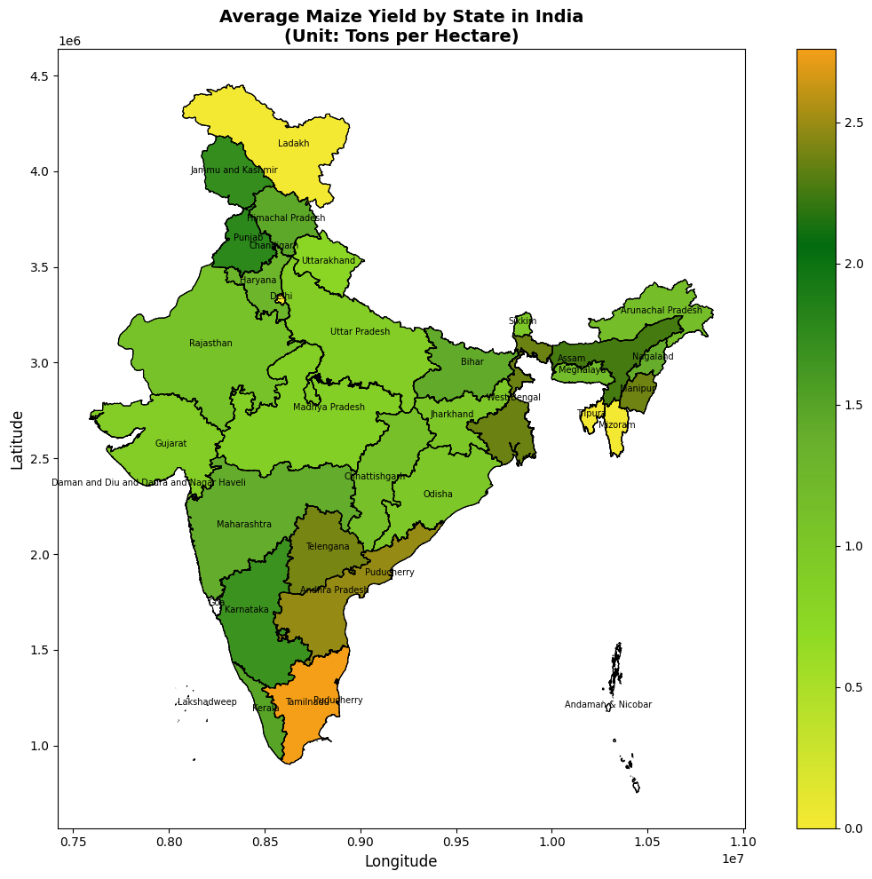
DISTRIBUTION OF AVERAGE MAIZE YIELD BY STATE IN INDIA (TONS/HECTARE)

Slide 16
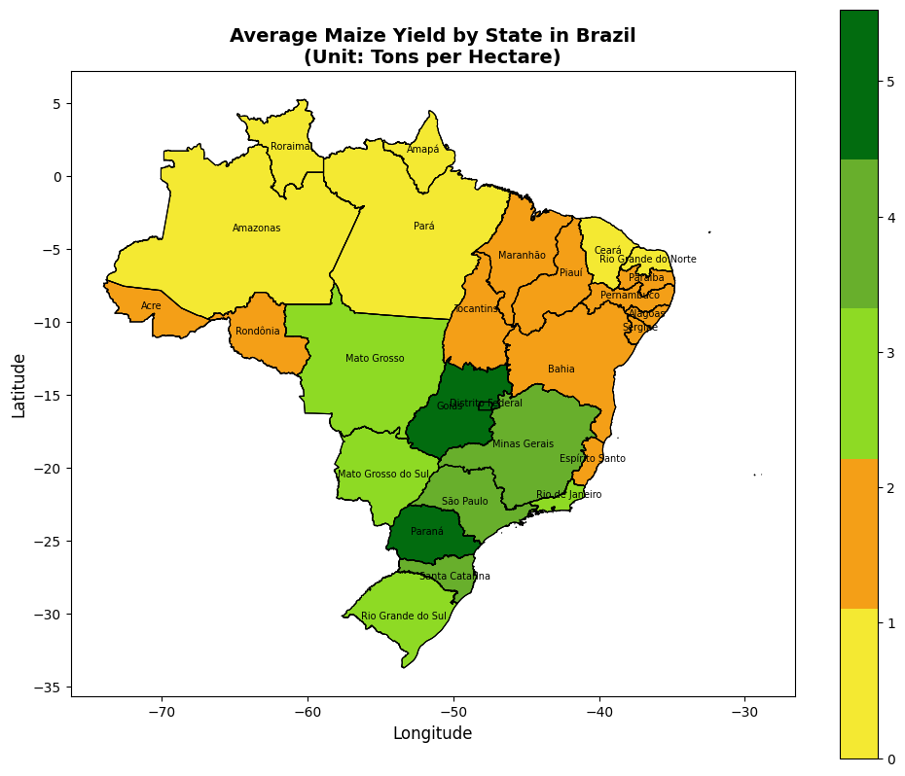
DISTRIBUTION OF AVERAGE MAIZE YIELD BY STATE IN BRAZIL (TONS/HECTARE)

Slide 17
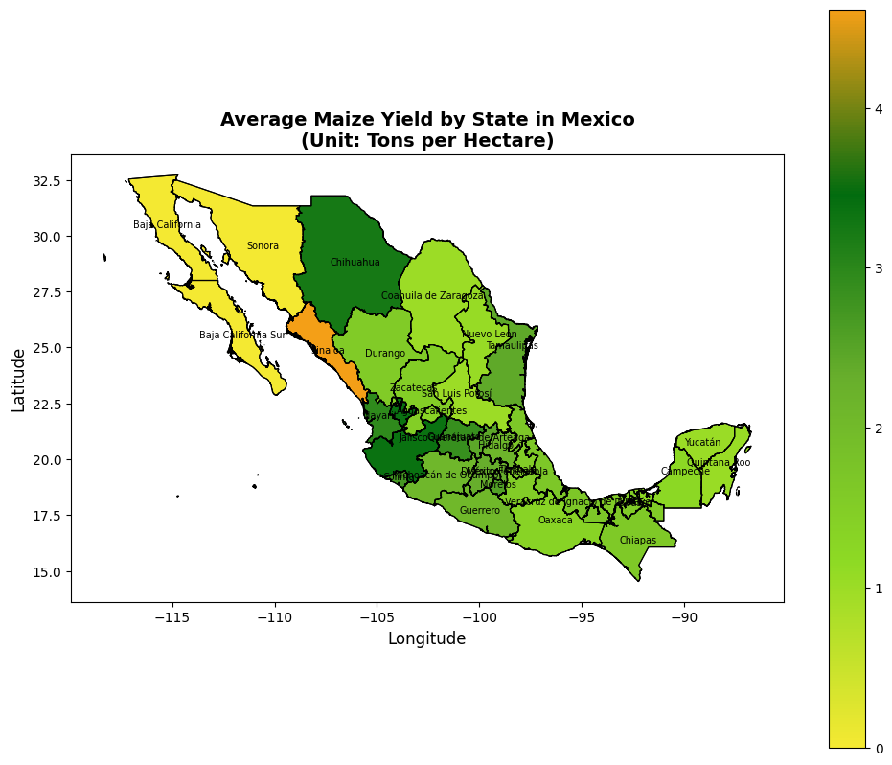
DISTRIBUTION OF AVERAGE MAIZE YIELD BY STATE IN MEXICO (TONS/HECTARE)

Slide 18
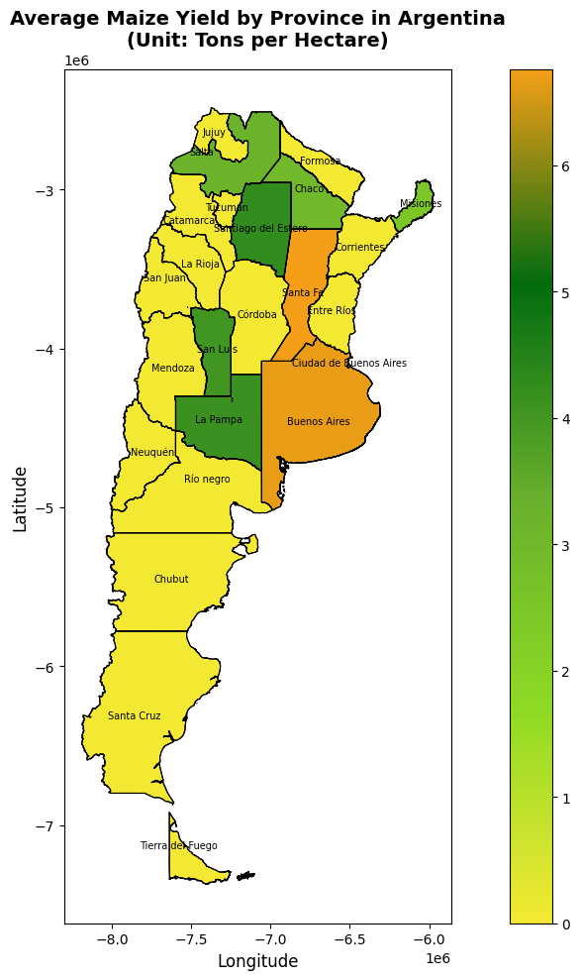
DISTRIBUTION OF AVERAGE MAIZE YIELD BY STATE IN ARGENTINA (TONS/HECTARE)

Slide 19
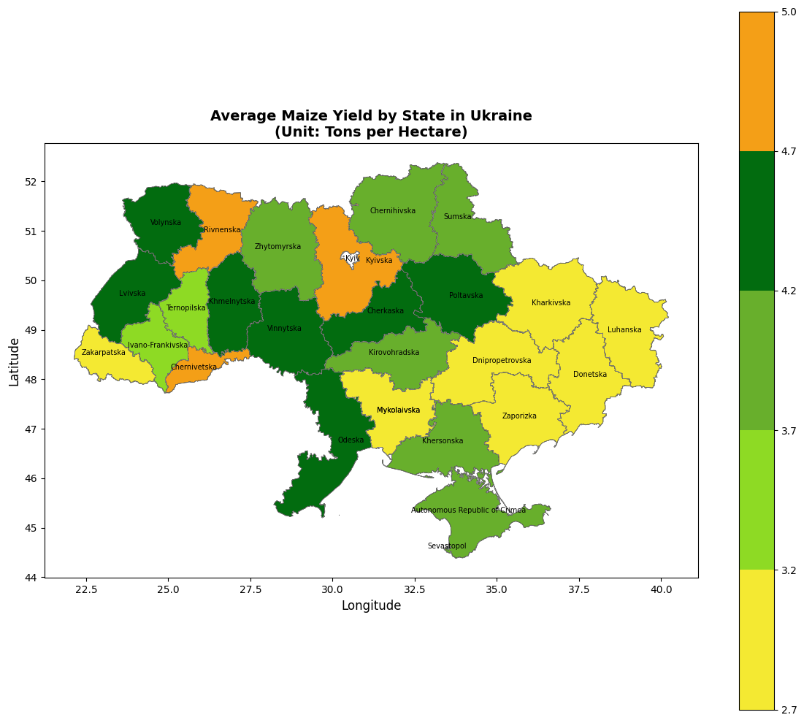
DISTRIBUTION OF AVERAGE MAIZE YIELD BY STATE IN UKRAINE (TONS/HECTARE)

Slide 20
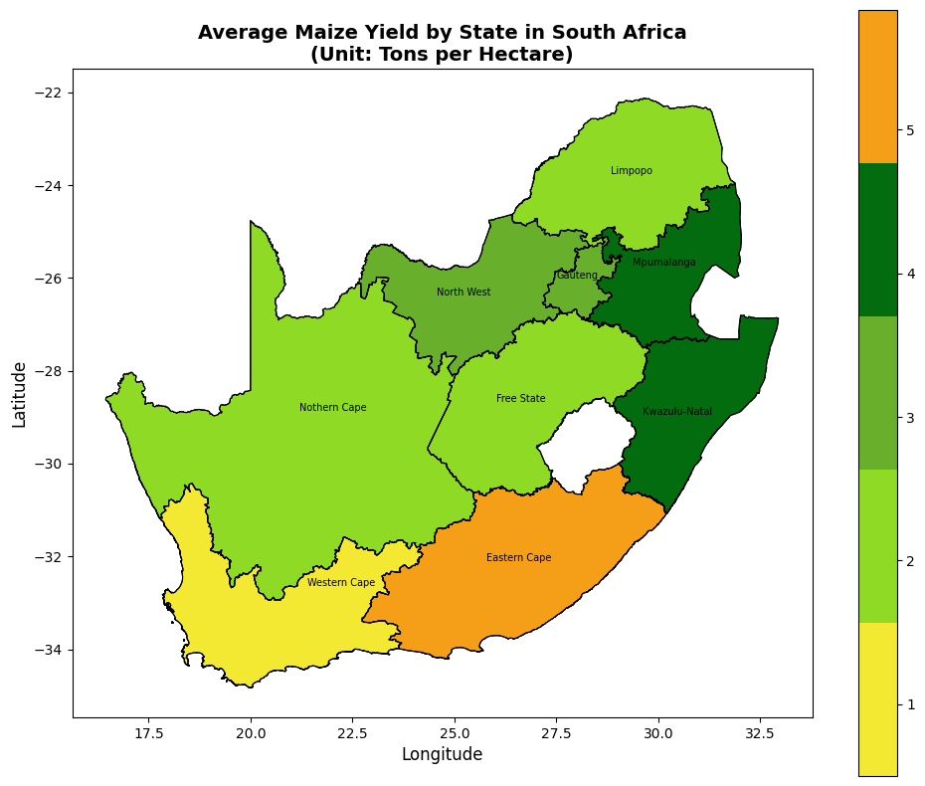
DISTRIBUTION OF AVERAGE MAIZE YIELD BY STATE IN SOUTH AFRICA (TONS/HECTARE)

Slide 21
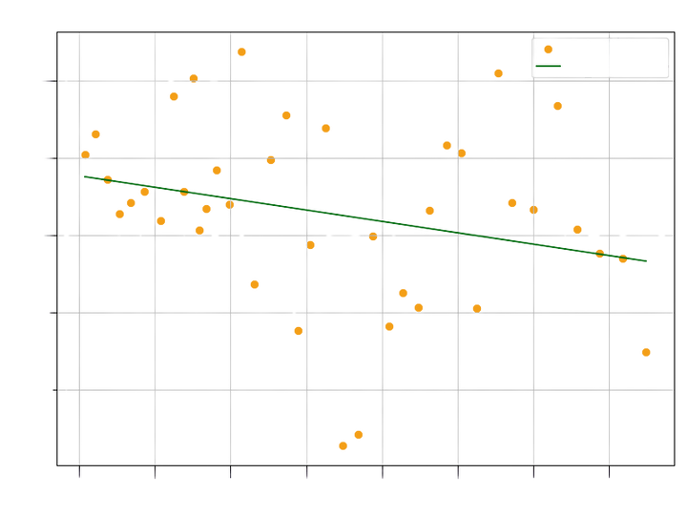
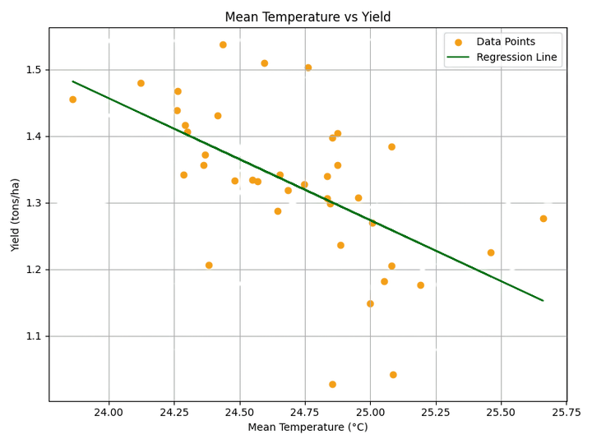
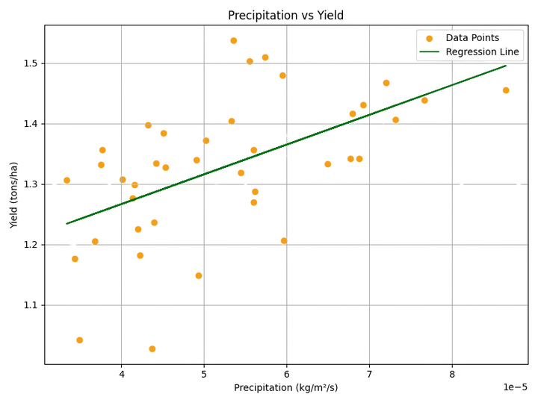
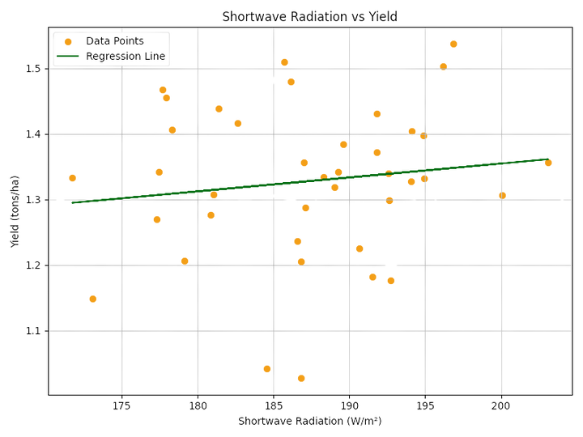
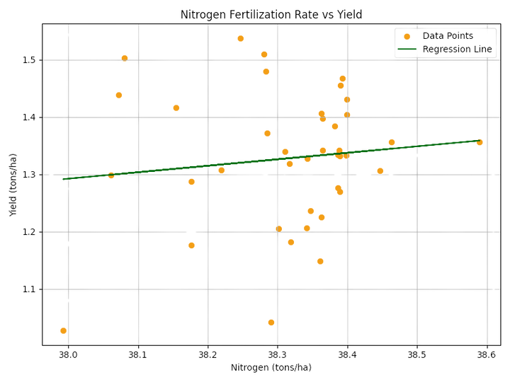
REGRESSION ANALYSIS
CO2 CONCENTRATION VS YIELD
DATA POINTS
REGRESSION LINE
1.5
1.4
1.3
YIELD (TONS/HA)
1.2
1.1
340
350
360
370
380
390
400
410
CO2 (PPM)

Slide 22
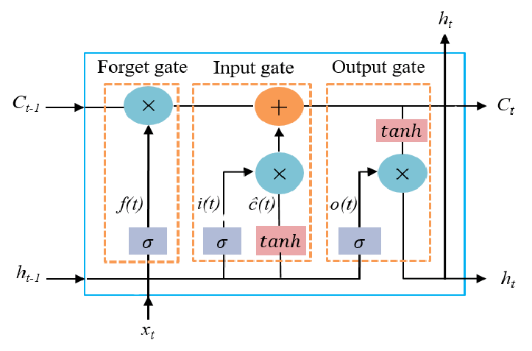
LSTM (LONG SHORT-TERM MEMORY)
A type of Recurrent Neural Network (RNN) designed to capture long-term dependencies in sequential data.
Well-suited for time-series crop yield prediction using weather, soil, and climate trends.
LSTM cells contain memory gates to retain important information and forget irrelevant data.
Can handle complex relationships in multi-year agricultural data (e.g., rainfall, temperature, CO₂)

Slide 23
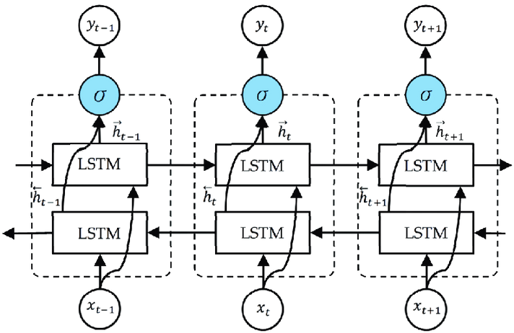
BILSTM
(BIDIRECTIONAL LSTM)
An extension of LSTM that processes input sequences in both forward and backward directions.
Captures past and future context in the data, improving prediction accuracy.
Effective when temporal dependencies aren't strictly unidirectional (e.g., growing season effects).
Useful for learning patterns where yield is influenced by lagging and leading indicators.

Slide 24
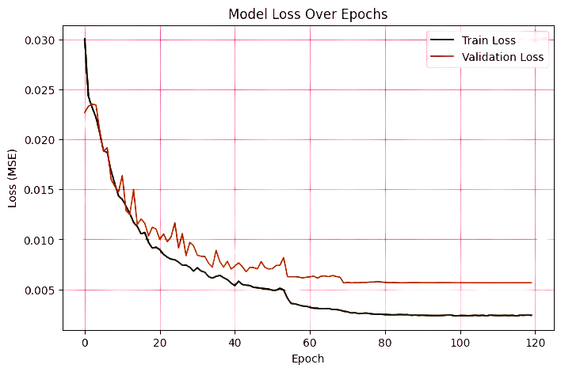
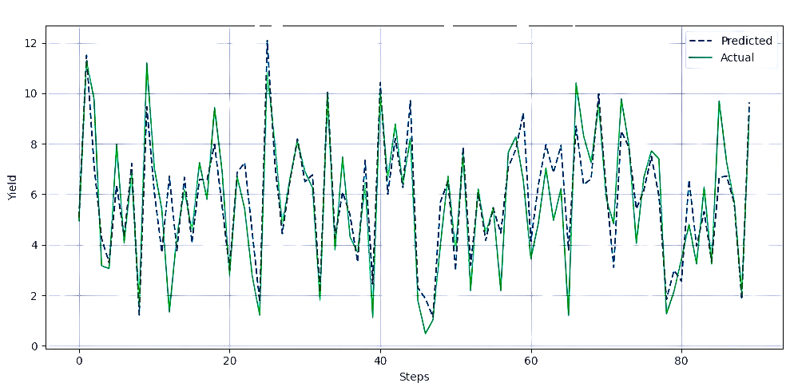
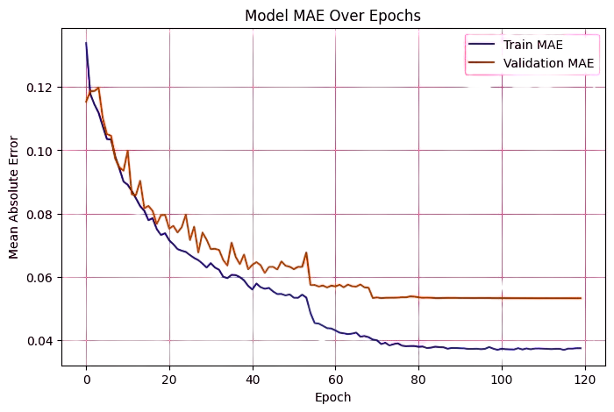
MODEL LOSS AND ACCURACY
Crop Yield Prediction with Sequence Langth = 240

Slide 25
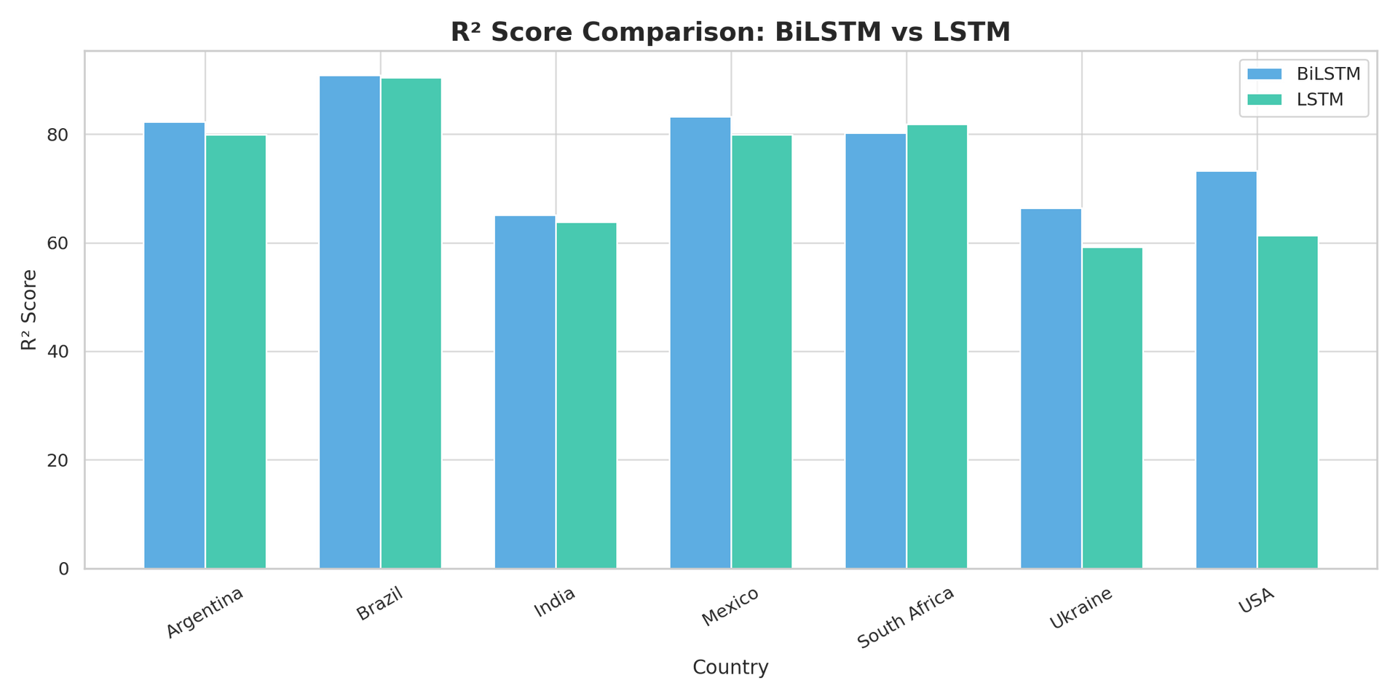

Slide 26
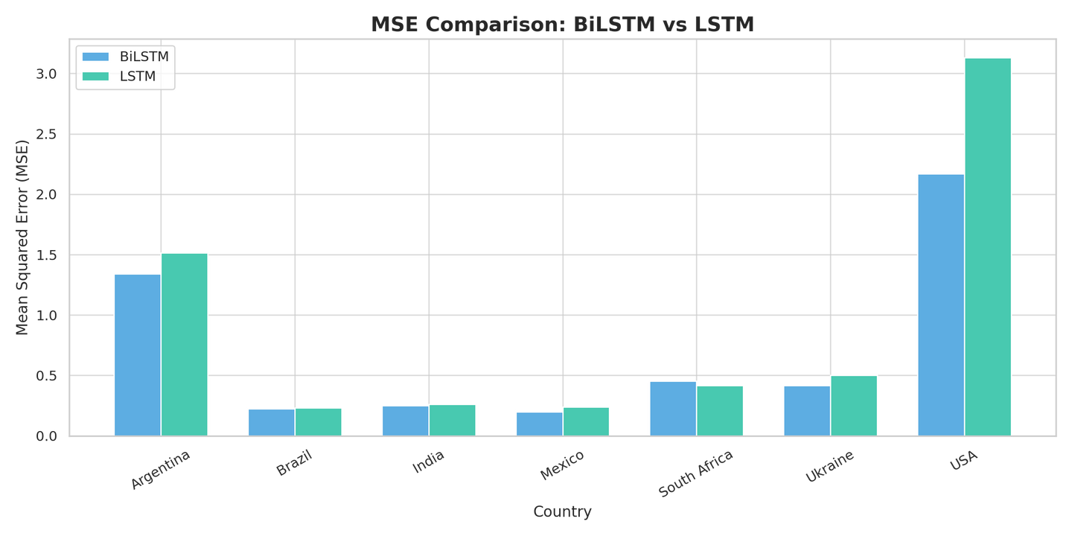
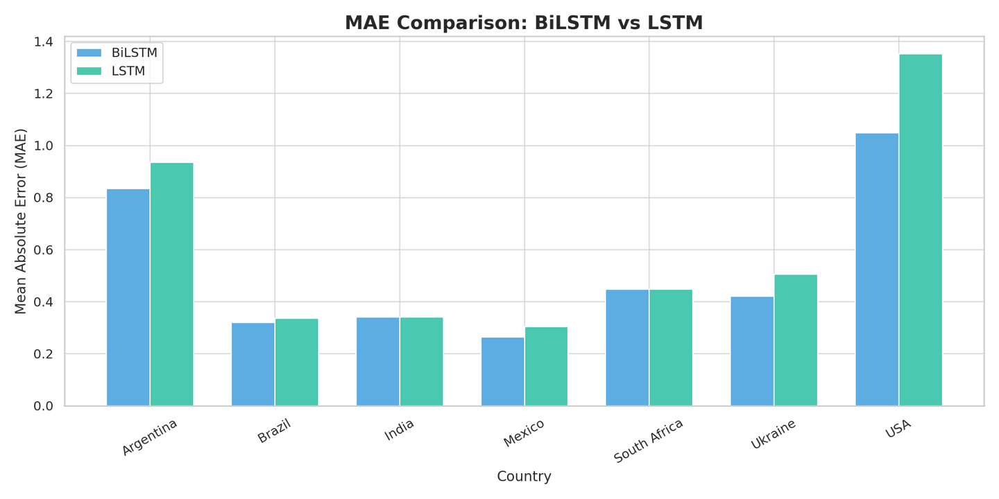

Slide 27
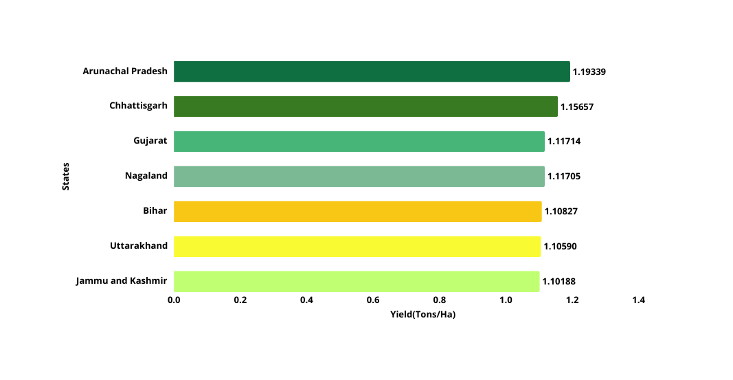
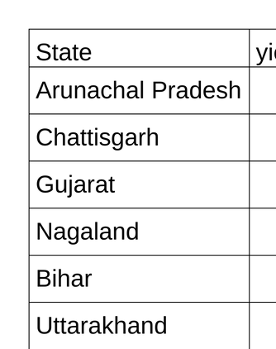
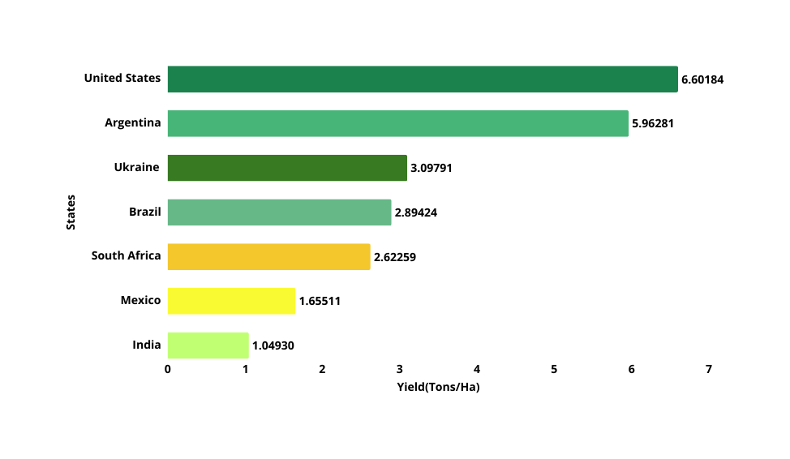
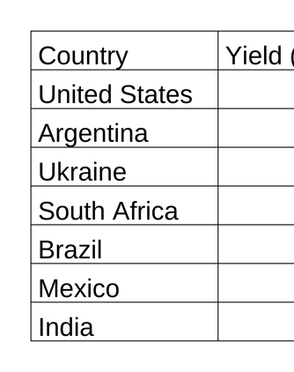
PREDICTED DATA ANALYSIS
AVERAGE MAIZE YIELD OF INDIA
AVERAGE MAIZE YIELD BY COUNTRY

Slide 28
CONCLUSION
Our study shows that maize crop yield is strongly affected by weather conditions like temperature, rainfall, and sunlight. Countries like the U.S., Argentina, and Brazil have high yields due to good climate and advanced farming, while India, Mexico, Ukraine, and South Africa face more challenges like poor soil and changing weather. We used data to understand these patterns and built LSTM and BiLSTM models with a simple GUI to help visualize and predict crop yields more easily. This tool can help farmers and decision-makers plan smarter for the future.

Slide 29
REFERENCES
[1] Aruvansh Nigam, Saksham Garg, Archit Agrawal (2019). Crop Yield Prediction Using Machine Learning Algorithms-2019. https://ieeexplore.ieee.org/document/8985951
[2] D.Jayanarayana Reddy, Dr M. Rudra Kumar (2021) Crop Yield Prediction using Machine Learning Algorithm
2021. https://ieeexplore.ieee.org/abstract/document/9432236
[3] Akshay Kumar Gajula, Jaswanth Singamsetty, Vineela Chandra Dodda,Lakshmi Kuruguntla (2021). Prediction of Crop and Yield in Agriculture Using Machine Learning July 2021.https://ieeexplore.ieee.org/abstract/document/9579843
[4] Kavita Jhajharia , Pratistha Mathur , Sanchit Jain , Sukriti Nijhawan (2023), Crop Yield Prediction using Machine Learning and Deep Learning Techniques. https://doi.org/10.1016/j.procs.2023.01.023
[5]. Sharma, Priyanka & Dadheech, Pankaj & Aneja, Nagender & Aneja, Sandhya. (2023). Predicting Agriculture Yields Based on Machine Learning Using Regression and Deep Learning. IEEE Access. PP. 1-1. 10.1109/ACCESS.2023.3321861.
[6]. Sai Nishant, Potnuru & Venkat, Pinapa & Avinash, Bollu & Jabber, B. (2020). Crop Yield Prediction based on Indian Agriculture using Machine Learning. 1-4. 10.1109/INCET49848.2020.9154036.
[7] Thomas van Klompenburga , Ayalew Kassahuna , Cagatay Catalb(2020). Crop yield prediction using machine learning: A systematic literature review. https://doi.org/10.1016/j.compag.2020.105709
[8] Alejandro Morales, Francisco J. Villalobos (2023). Using Machine Learning for Crop Yield Prediction In the Past or Future. https://www.frontiersin.org/journals/plant-science/articles/10.3389/fpls.2023.1128388/full

Slide 30
ACKNOWLEDGEMENT
The making of the project “Crop yield prediction for Google grid” involves the contribution of many people. We express deep gratitude to our project guide and mentor Prof. Poonam Bari for her constant motivation to think out of the box and immense contribution throughout this project. We convey our heartfelt thanks to the project coordinator Prof. Lakshmi Gadikar for supporting and guiding us throughout the process. We would also like to convey our heartfelt gratitude to the Head of the Department of Information Technology, Dr. Shubhangi Vaikole for her constant support and motivation. We would like to convey our sincere thanks to Dr. S.M. Khot, principal of Fr. C. Rodrigues Institute of Technology, Vashi for giving us the opportunity to showcase our skills and providing us with the necessary resources.We also extend our heartfelt thanks to our families and well-wishers.

Slide 31

Thank you!

Slide 32
Country | BiLSTM | LSTM
Argentina | R² Score = 82.28 Mean Squared Error (MSE) = 1.3393 Mean Absolute Error (MAE) = 0.8342 | R² Score = 79.95 Mean Squared Error (MSE) = 1.5148 Mean Absolute Error (MAE) = 0.9350
Brazil | R² Score = 90.86 Mean Squared Error (MSE) = 0.2226 Mean Absolute Error (MAE) = 0.3204 | R² Score = 90.46 Mean Squared Error (MSE) = 0.2323 Mean Absolute Error (MAE) = 0.3367
India | R² Score = 65.05 Mean Squared Error (MSE) = 0.2518 Mean Absolute Error (MAE) = 0.3413 | R² Score = 63.80 Mean Squared Error (MSE) = 0.2608 Mean Absolute Error (MAE) = 0.3412
Mexico | R² Score = 83.23 Mean Squared Error (MSE) = 0.1985 Mean Absolute Error (MAE) = 0.2639 | R² Score = 79.95 Mean Squared Error (MSE) = 0.2374 Mean Absolute Error (MAE) = 0.3046

Slide 33
Country | BiLSTM | LSTM
South Africa | R² Score = 80.23 Mean Squared Error (MSE) = 0.4543 Mean Absolute Error (MAE) = 0.4489 | R² Score = 81.80 Mean Squared Error (MSE) = 0.4184 Mean Absolute Error (MAE) = 0.4485
Ukraine | R² Score = 66.34 Mean Squared Error (MSE) = 0.4148 Mean Absolute Error (MAE) = 0.4216 | R² Score = 59.25 Mean Squared Error (MSE) = 0.5021 Mean Absolute Error (MAE) = 0.5052
USA | R² Score = 73.25 Mean Squared Error (MSE) = 2.1696 Mean Absolute Error (MAE) = 1.0488 | R² Score = 61.40 Mean Squared Error (MSE) = 3.1311 Mean Absolute Error (MAE) = 1.3525

Slide 34
SQL INNER JOIN for Environmental Data
Add Day Column & Geopy Mapping
Country/State Analysis
LSTM & BiLSTM Model Training
Yield Prediction
Data Collection
Transform Format: Horizontal to Vertical
Data Normalization & Feature Selection
Trend & Correlation Analysis
Performance Evaluation: RMSE, R²

